Slide 1



Watershed Districts: Statutes and Governance Structure
Emily Javens, Executive Director
Presentation to the Legislative Coordinating Commission’s Subcommittee on MN Water Policy
March 9, 2020 | St. Paul, MN
www.mnwatershed.org

Slide 2
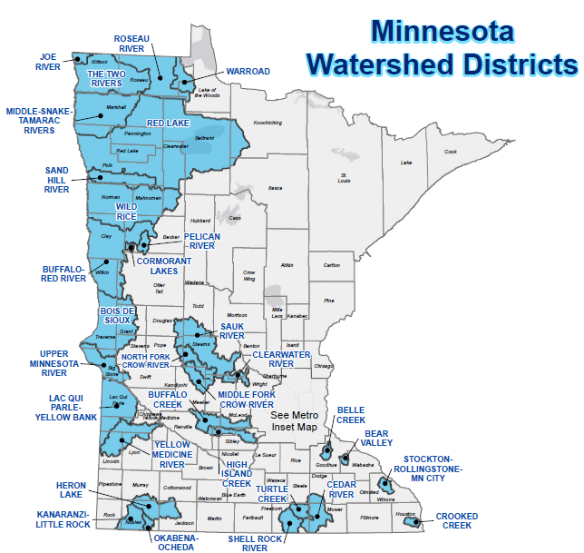
Non-metro Watershed Districts
1955
MN Watershed Act

Slide 3
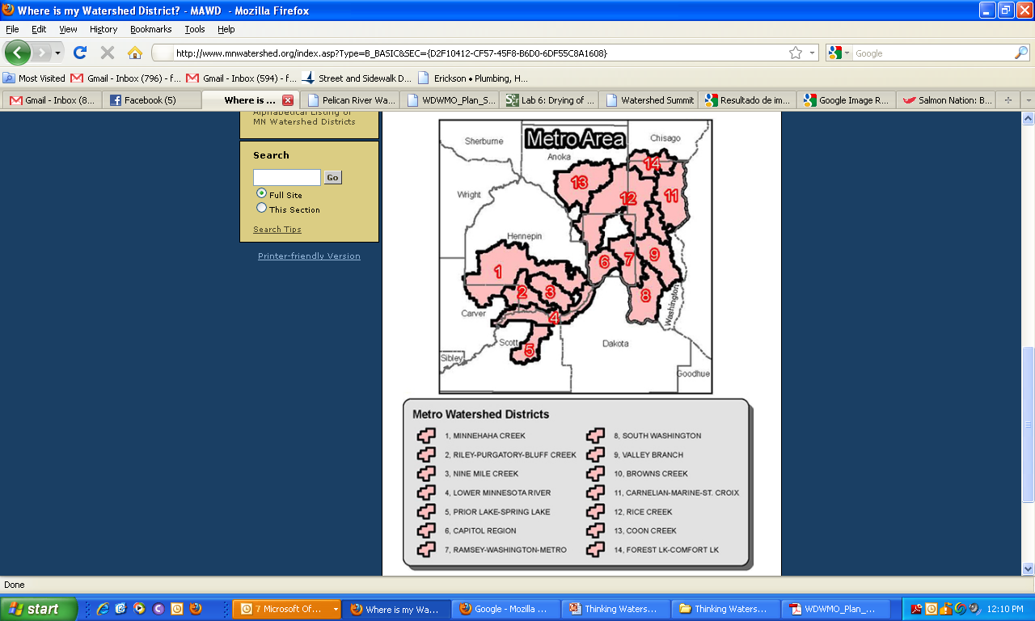
Metro Watershed Districts

Slide 4
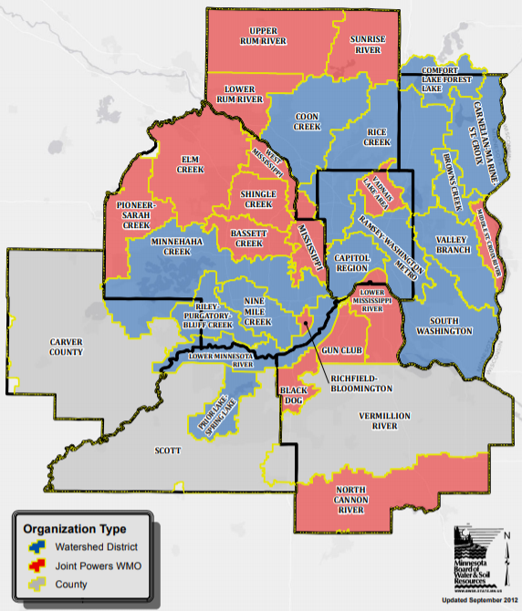
Water Management Organizations (WMOs)
1982
Metro Surface Water
Management Act

Slide 5
Purposes for Establishment
103D.201 Subdivision 1.
To control or alleviate damage from floodwaters (#1)
To control or alleviate soil erosion and siltation of water courses or water basins (#10)
To divert or change all or part of watercourses (#6)
To protect or enhance the water quality in watercourse or water basins (#13)
To improve stream channels for drainage, navigation, and any other public purpose (#2)
To repair, improve, relocate, modify, consolidate, and abandon all or part of drainage systems within a watershed district (#9)
To reclaim or fill wet and overflowed land (#3)

Slide 6
Purposes for Establishment
103D.201 Subdivision 1.
To regulate the flow of streams and conserve the streams’ water (#5)
To regulate improvements by riparian property owners of the beds, banks, and shores of lakes, streams, and wetlands for preservation and beneficial public use (#11)
To provide for sanitation and public health, and regulate the use of stream, ditches, or watercourses to dispose of waste (#8)
To provide for the protection of groundwater and regulate its use to preserve it for beneficial purposes (#14)
To provide for hydroelectric power generation (#12)
To provide a water supply for irrigation (#4)
To provide or conserve water supply for domestic, industrial, recreational, agricultural, or other public use (#7)

Slide 7
Watershed Planning
103D.401 Subdivision 1.
103D.401 WATERSHED MANAGEMENT PLAN.
Subdivision 1. Contents. The managers must adopt a watershed management plan for any and all of the purposes for which a watershed district may be established. The watershed management plan must give a narrative description of existing water and water-related problems, possible solutions to the problems, and the general objectives of the watershed district.
Review and Public Notice Requirements
Copies to: BWSR, DNR, Met Council, municipalities, counties, SWCDs
DNR, Met Council required to comment within 60 days
BWSR holds a hearing with notices to municipalities, SWCDs, counties, DNR, local newspapers

Slide 8
Watershed Projects
GENERAL PROCEDURE TO ESTABLISH PROJECTS
103D.701 Project Initiation
103D.705 Project Petition
103D.711 Engineer’s Report
103D.715 Appraisers; Determining Benefits and Damages
103D.721 Managers; Determining Benefits and Damages
103D.725 Benefited Property; Determination
103D.729 Water Management District
103D.730 Storm Water Facilities
103D.731 Appraisers’ Report; Examination
103D.735 Hearing on Petition and Reports
103D.741 Hearing Notice
103D.745 Final Hearing
103D.331 ADVISORY COMMITTEE.
Subdivision 1.Purpose.
The managers must annually appoint an advisory committee to advise and assist the managers on all matters affecting the interests of the watershed district and make recommendations to the managers on all contemplated projects and improvements in the watershed district.

Slide 9
Watershed Regulations
103D.341 Subdivision 1.
MN Statute 103D.341 Rules
Subdivision 1. Requirement. The managers must adopt rules to accomplish the purposes of this chapter and to implement the powers of the managers.
Subd. 2.Procedure.
(a) Rules of the watershed district must be adopted or amended by a majority vote of the managers, after public notice and hearing.
Accountability / Transparency
45-day review and comment period for agency (BWSR) review
45-day review and comment period for transportation authorities
Public notice required for public hearing
Public notice required for adopted rules
Notification requirement for municipalities

Slide 10
Watershed Funding.
RURAL
METRO
103D.905 FUNDS OF WATERSHED DISTRICT.
Subd. 3.General fund.
A general fund, consisting of an ad valorem tax levy, may not exceed 0.048 percent of estimated market value, or $250,000, whichever is less. The money in the fund shall be used for general administrative expenses and for the construction or implementation and maintenance of projects of common benefit to the watershed district.
103B.241 LEVIES.
Subdivision 1. Watershed plans and projects.
Notwithstanding chapter 103D, a local government unit or watershed management organization may levy a tax to pay the increased costs of preparing a plan under sections 103B.231 and 103B.235 or for projects identified in an approved and adopted plan necessary to implement the purposes of section 103B.201.

Slide 11
Watershed Reporting
103D.341 Subdivision 1.
103D.351 ANNUAL REPORT.
(a) The managers must prepare a yearly report of the financial conditions of the watershed district, the status of all projects, the business transacted by the watershed district, other matters affecting the interests of the watershed district, and a discussion of the managers' plans for the succeeding year
103D.355 ANNUAL AUDIT.
Subdivision 1.Requirement.
The managers must have an annual audit completed of the books and accounts of the watershed district. The annual audit may be made by a private certified public accountant or by the state auditor.

Slide 12
Watershed Districts: Statutes and Governance Structure
Thank you!
Emily Javens, Executive Director
Emily@MNWatershed.org
651-440-9407
www.mnwatershed.org

